Slide 1
Floating Point Arithmetic

Slide 2
Floating Point Addition
Example:
Assumption:
We can store 4 decimal digits for significand part
and 2 decimal digits for the exponent.

Slide 3

Floating Point Addition
Example:
Step 1: Align decimal point of the number that has smaller exponent.
( exponents of both the numbers must match!!!)

Slide 4
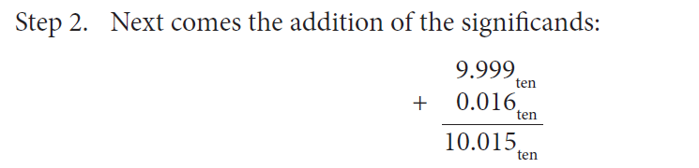

Floating Point Addition
Example:

Slide 5
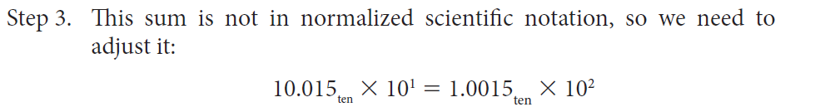
Floating Point Addition
Example:

Slide 6

Floating Point Addition
Step 4: Rounding up (since we have assumed that four digits will be stored.)

Slide 7

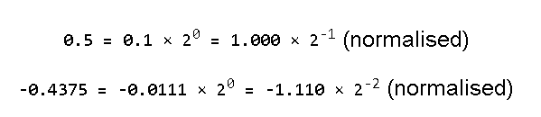
Binary Floating Point Addition
Perform:
Step1: Convert the numbers into binary and normalize them.

Slide 8

Binary Floating Point Addition
Step 2: Rewrite the smaller number such that its exponent matches with the exponent of the larger number.

Slide 9

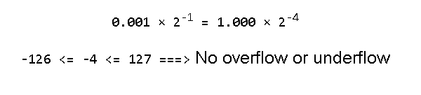
Binary Floating Point Addition
Step 3: Add the mantissas/significands
Step 4: Normalise the sum, checking for overflow/underflow.

Slide 10


Floating Point Multiplication
Example : 1.110 × 10¹⁰ × 9.200 × 10⁻⁵
Step 1: Add the exponents:
Step 2: Multiply the mantissas:

Slide 11


Floating Point Multiplication
Step 3: Normalise the result
Step 4: Round it

Slide 12

Example multiplication in binary:
1.000 × 2⁻¹ × -1.110 × 2⁻²
Step 1: Add the biased exponents

Slide 13
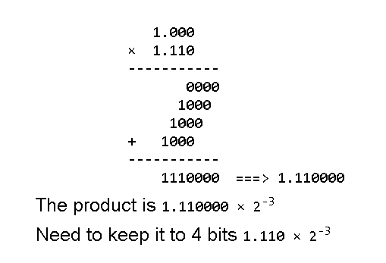
Example multiplication in binary:
Step 3: Multiply the mantissas

Slide 14
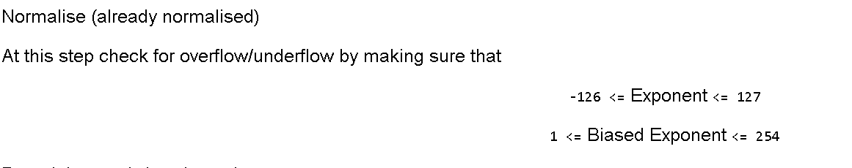
Example multiplication in binary:
Step 3:

Slide 15
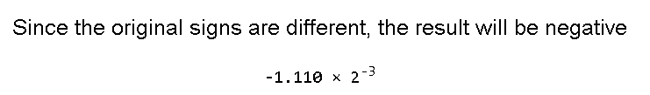
Example multiplication in binary:
Step 5: Adjust the signs.

